Slide 1
Tell Me Something True

Slide 2
Instructions
The class is split into two teams.
A prompt will be shown with some information about a function.
Teams will take turns saying “something true” (and Precalc related) about the given data.
Teams will go back and forth until one team can not come up with “something true” about the prompt. The other team then earns a bonus.
Bonus points are given for great responses.
All players on a team must take turns saying “something true”.

Slide 3
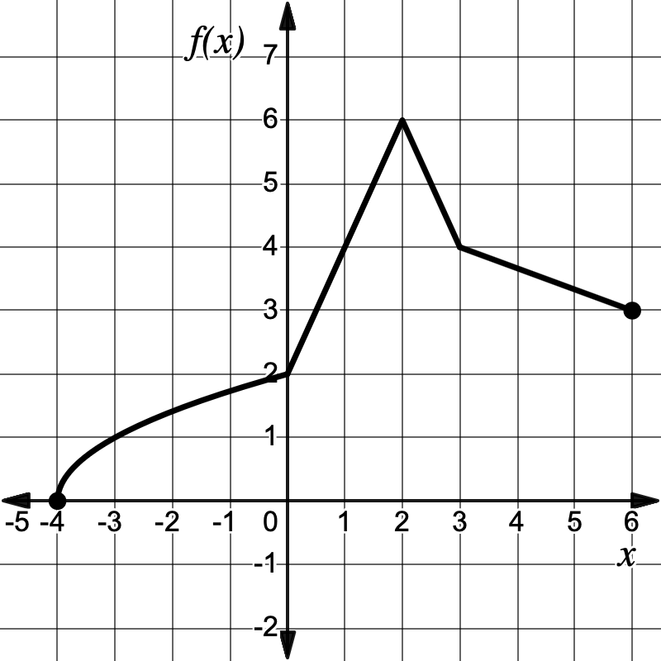
The graph of f is shown below on [-4,6].

Slide 4
Selected values of a polynomial function g are given in the table below.
x | -2 | 0 | 2 | 4 | 6 | 8 | 10
g(x) | 7 | 12 | 14 | 13 | 9 | 2 | -8

Slide 5
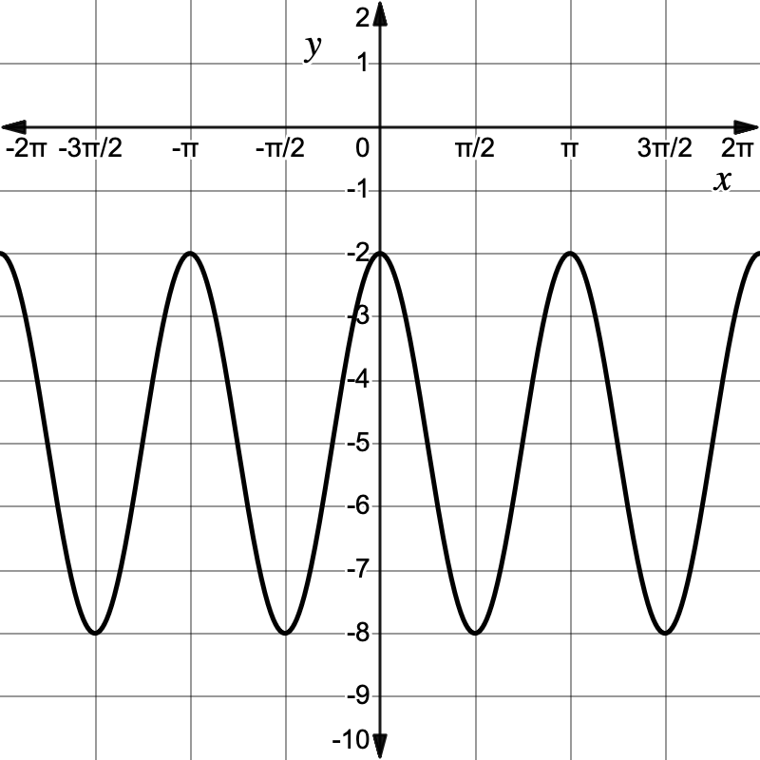
The graph of h is shown below.

Slide 6
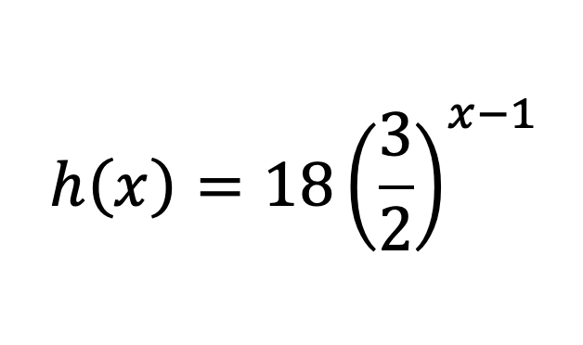

Slide 7
Selected values of a one-to-one function f are given in the table below.
x | -5 | -3 | 0 | 1 | 4 | 8 | 11
f(x) | 25 | 21 | 16 | 13 | 4 | -2 | -6

Slide 8
An element is known to decay by 50% every 7 days.

Slide 9
