Slide 1
WOULD THIS GET CREDIT? Debriefing the 2024 AP Stats Exam
Luke Wilcox
Lindsey Gallas

Slide 2
2024 #1

Slide 3
2024 #1

Slide 4
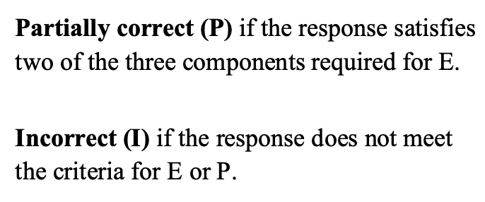
2024 #1 Rubric – Section 1
QuickNotes
Identify procedure
Correct hypotheses
Context

Slide 5
2024 #1 Section 1 Model Solution
1. Identify procedure
2. Correct hypotheses
3. Context
E, P, or I?
yes
yes
yes
E → Essentially correct

Slide 6
WOULD THIS GET CREDIT?
For each student response in Section 1, decide if each component is satisfied.
Determine the grade for this section:
E → Essentially correct
P → Partially correct
I → Incorrect
Use highlighter and red pen

Slide 7
2024 #1 Rubric – Section 1
QuickNotes
Identify procedure
Correct hypotheses
Context
Notes:
LEAVE THIS SLIDE UP WHILE STUDENTS WORK

Slide 8
2024 #1 Section 1 Student Response #1
1. Identify procedure
2. Correct hypotheses
3. Context
E, P, or I?
yes
yes
yes
E → Essentially correct

Slide 9
2024 #1 Section 1 Student Response #2
1. Identify procedure
2. Correct hypotheses
3. Context
E, P, or I?
no
no
yes
I → Incorrect
missing “proportions”

Slide 10
2024 #1 Section 1 Student Response #3
1. Identify procedure
2. Correct hypotheses
3. Context
E, P, or I?
yes
yes
no
P → Partially correct
past tense

Slide 11
2024 #1 Rubric – Section 2
QuickNotes
Independence condition
Large Counts condition
Correct z-statistic
Correct p-value

Slide 12
2024 #1 Section 2 Model Solution
Independence condition
Large Counts condition
Correct z-statistic
Correct p-value
E, P, or I?
yes
yes
yes
yes
E → Essentially correct

Slide 13
WOULD THIS GET CREDIT?
For each student response in Section 2, decide if each component is satisfied.
Determine the grade for this section:
E → Essentially correct
P → Partially correct
I → Incorrect
Use highlighter and red pen

Slide 14
2024 #1 Rubric – Section 2
QuickNotes
Independence condition
Large Counts condition
Correct z-statistic
Correct p-value
Notes:
LEAVE THIS SLIDE UP WHILE STUDENTS WORK

Slide 15
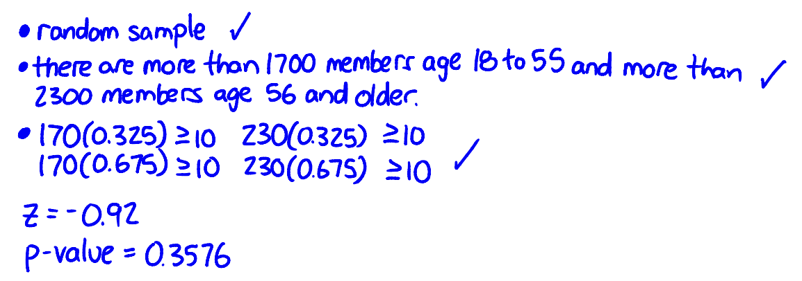
2024 #1 Section 2 Student Response #1
Independence condition
Large Counts condition
Correct z-statistic
Correct p-value
E, P, or I?
no
yes
yes
yes
P → Partially correct

Slide 16
2024 #1 Section 2 Student Response #2
Independence condition
Large Counts condition
Correct z-statistic
Correct p-value
E, P, or I?
yes
yes
yes
yes
E → Essentially correct

Slide 17
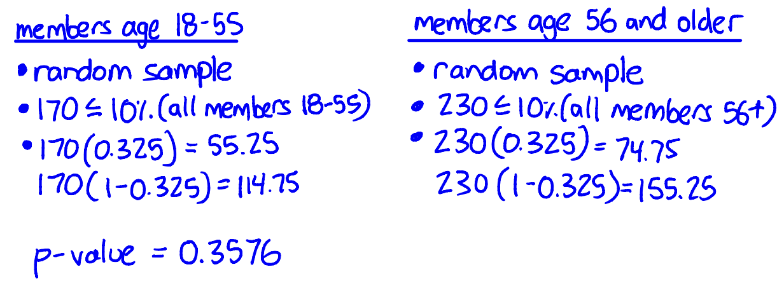
2024 #1 Section 2 Student Response #3
Independence condition
Large Counts condition
Correct z-statistic
Correct p-value
E, P, or I?
yes
no
no
yes
P → Partially correct
missing z-statistic
no comparison to 10

Slide 18
2024 #1 Rubric – Section 3
QuickNotes
Linkage + decision
Conclusion in context
1
2
3
4

Slide 19
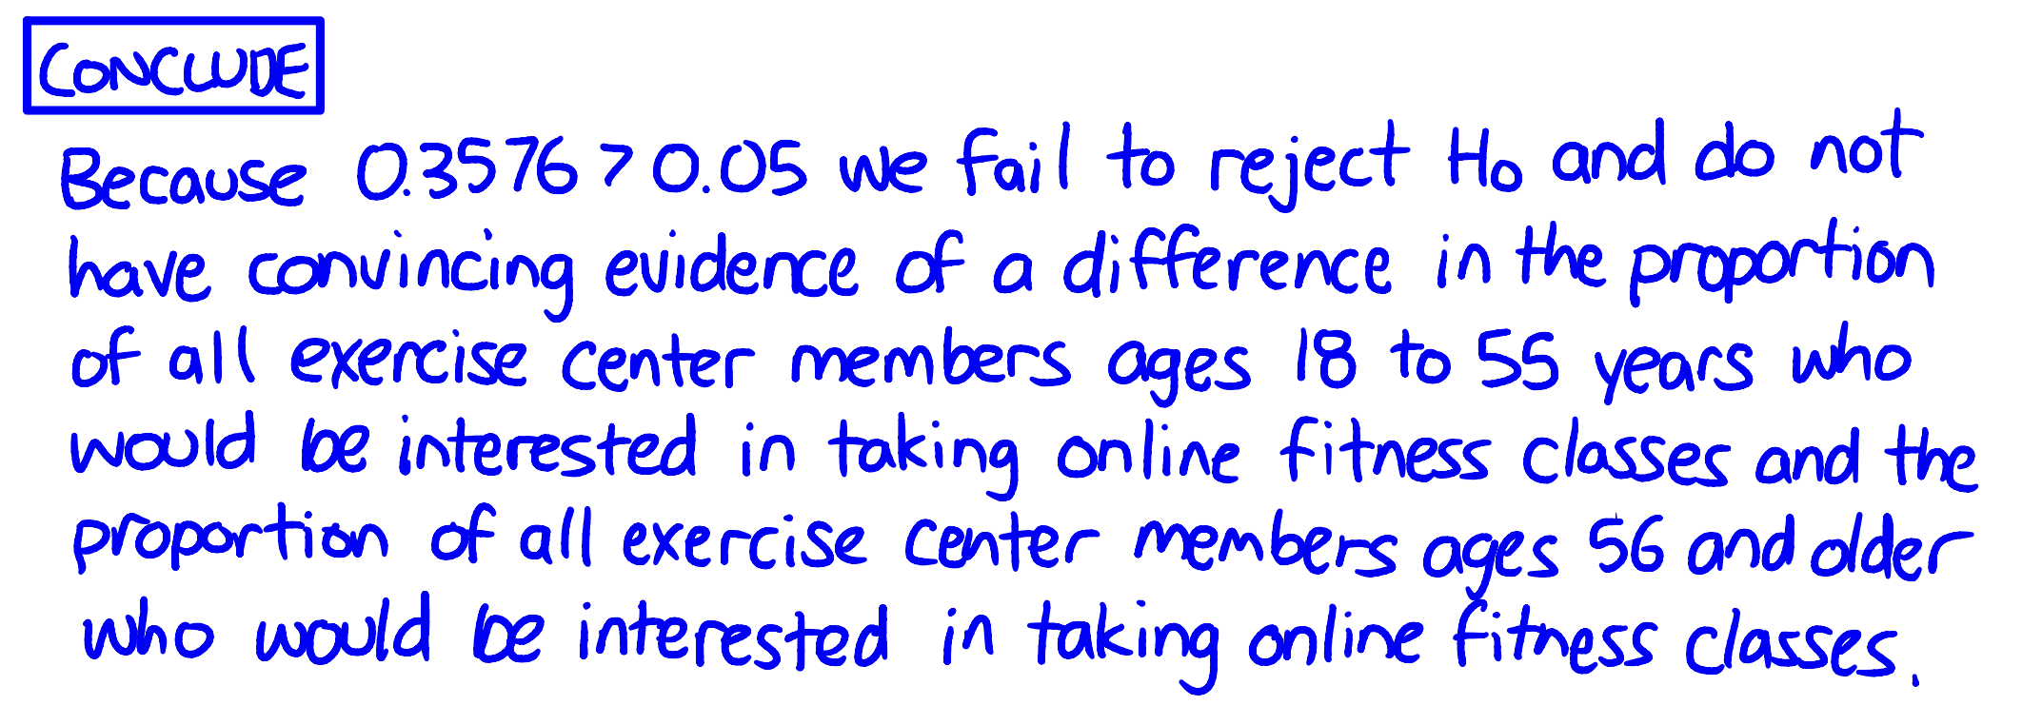
2024 #1 Section 3 Model Solution
Linkage + decision
Conclusion in context
E, P, or I?
yes
yes
E → Essentially correct
1
3
2
4

Slide 20
WOULD THIS GET CREDIT?
For each student response in Section 3, decide if each component is satisfied.
Determine the grade for this section:
E → Essentially correct
P → Partially correct
I → Incorrect
Use highlighter and red pen

Slide 21
2024 #1 Rubric – Section 3
QuickNotes
Linkage + decision
Conclusion in context
Notes:
LEAVE THIS SLIDE UP WHILE STUDENTS WORK

Slide 22
2024 #1 Section 3 Student Response #1
Linkage + decision
Conclusion in context
E, P, or I?
no
no
I → Incorrect

Slide 23
2024 #1 Section 3 Student Response #2
Linkage + decision
Conclusion in context
E, P, or I?
yes
no
P → Partially correct

Slide 24
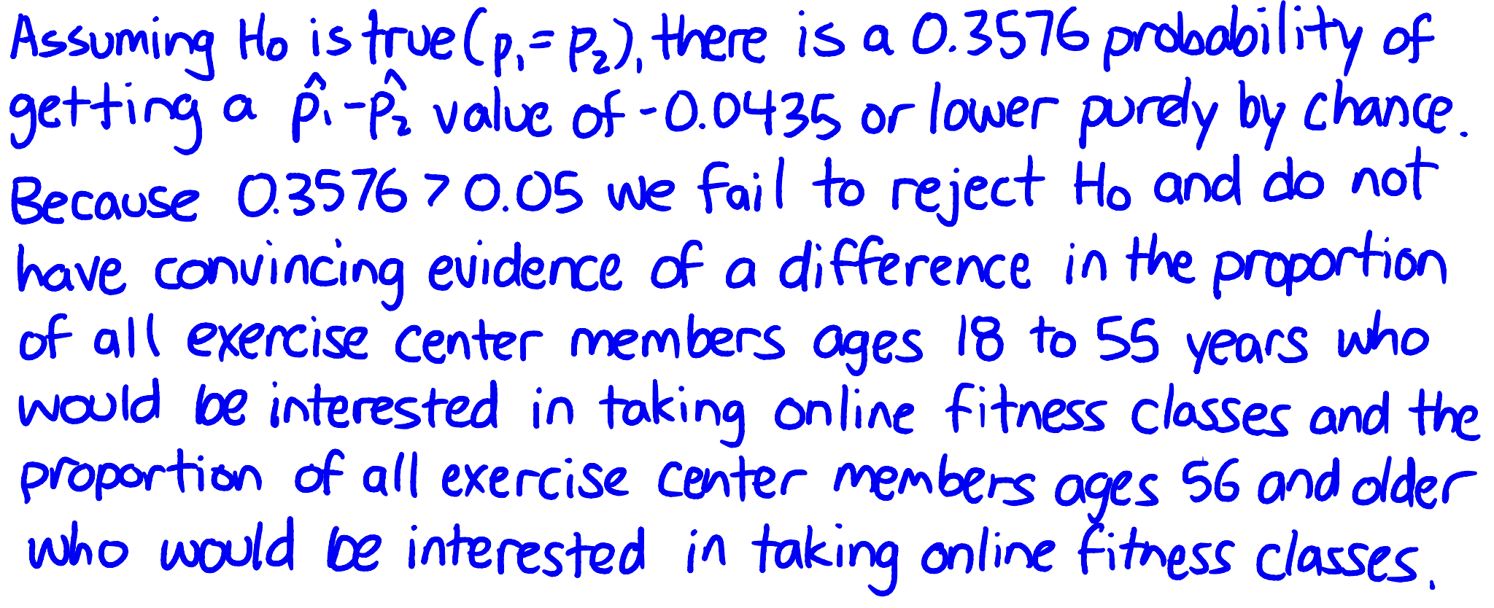
2024 #1 Section 3 Student Response #3
Linkage + decision
Conclusion in context
E, P, or I?
yes
yes
E → Essentially correct
P → Partially correct

Slide 25
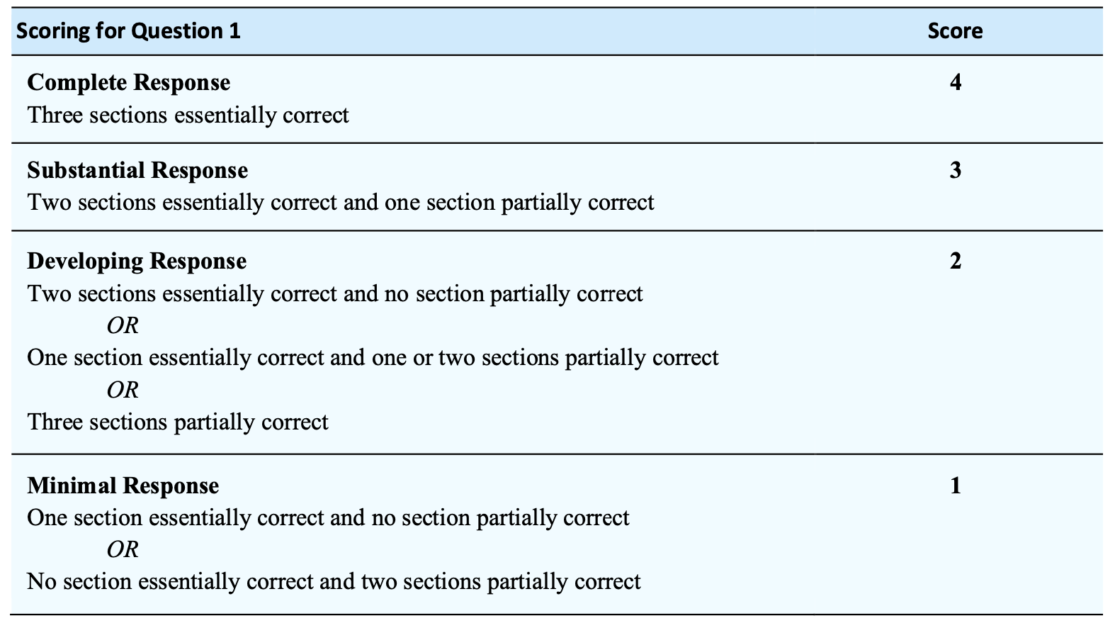
2024 #1 Reflection
EEE
EEP
EEI
EPP
EPI
PPP
EII
PPI

Slide 26
2024 #1 Reflection
What did you learn from this experience?

Slide 27
2024 #1 Tips for Success
Tips for Success
Don’t forget the 10% condition.
Notation matters!
Every free response answer should be in context.
Use the words from the prompt.
Use a consistent structure for inference (like the 4C Method)

Slide 28
Where to Learn More?
Blog posts on Math Medic! (blog.mathmedic.com)
2023 FRQ #1 (Jennifer Waters)
2023 FRQ #2 (Luke Wilcox)
2023 FRQ #3 (June Beighley)
2023 FRQ #4 (Chris Viste)
2023 FRQ #5 (Penny Smeltzer)
2023 FRQ #6 (Leigh Nataro)
2024 FRQ #1 (Jeff Eicher, Jr.)
2024 FRQ #2 (Erica Chauvet)
2024 FRQ #3 (Penny Smeltzer)
2024 FRQ #4 (Terri Latham)

