Slide 1
AP Statistics
2020 Practice Exam
Today is an opportunity to practice for the 2020 AP Statistics Exam. You will complete two questions that are representative of the tasks you will see on this year’s exam within the time you will be allotted on the actual exam.
Please note that, while these questions are designed to be similar in structure and format to what you will see on this year’s AP Statistics Exam, they are not intended to be representative of the content that will be assessed.

Slide 2

Option 1: Copy-and-paste a typed response, and then click “Submit”
Best device to use: laptop or desktop computer
Type your response in Google Docs, Microsoft Word, Notes, or a similar application. Don’t include images. Save your work often.
Type your AP ID and initials at the top of the response.
When the timer has 5 minutes remaining, copy-and-paste your response into the space indicated, and click Submit.
Exam day setup: side-by-side windows
Window 1 – Chrome, Firefox, Safari, or Edge in which the exam question(s) will appear after you click on your e-ticket.
  Displays test question(s)
  Displays timer
  Use to paste and submit typed response
Window 2 – Where you type your document: a Google Doc, Microsoft Word, Notes, etc.

Slide 3

Option 2: Attach a document and then click “Submit”
Best device to use: laptop or desktop computer
Type your response in Google Docs, Microsoft Word, Notes, or a similar application. Don’t include images. Save your work often.
Save your document in one of these accepted file formats: .doc, .docx, .pdf, .txt, .odt
Type your AP ID and initials at the top of the response.
When the timer has 5 minutes remaining, attach your response and click Submit.
If your exam has two questions, you must create, save, attach, and submit two separate documents, one for each question.
Exam day setup: side-by-side windows
Window 1 – Chrome, Firefox, Safari or Edge in which the exam question(s) will appear after you click on your e-ticket.
  Displays test question(s)
  Displays timer
  Use to attach and submit text file
Window 2 – Where you type your document: a Google Doc, Microsoft Word, or Notes

Slide 4
Option 3: Attach photos of handwritten response and then click "Submit"
Best device to use: smartphone or tablet
1. Craft response via pen and paper
Write your AP ID, initials, and page number at the top of EACH page of the response.
Write your response clearly with dark pen or pencil.
When the timer has 5 minutes remaining, take a photo of your response in vertical orientation, i.e., not landscape.
One page per photo. If your response is longer than one page, you’ll need to attach multiple photos (maximum of 5 photos per test question) before clicking Submit.
Make sure to attach all of your pages before you click Submit.
Acceptable file formats: .png, .jpg, .jpeg.
Exam day setup:
Smart phone or tablet
  Displays test question (you may need to scroll within a question)
  Displays timer
  Use to take photos of written work
  Use to attach and submit photos of written work
2. Take picture of response
3. Attach photo(s) then click "Submit"

Slide 5
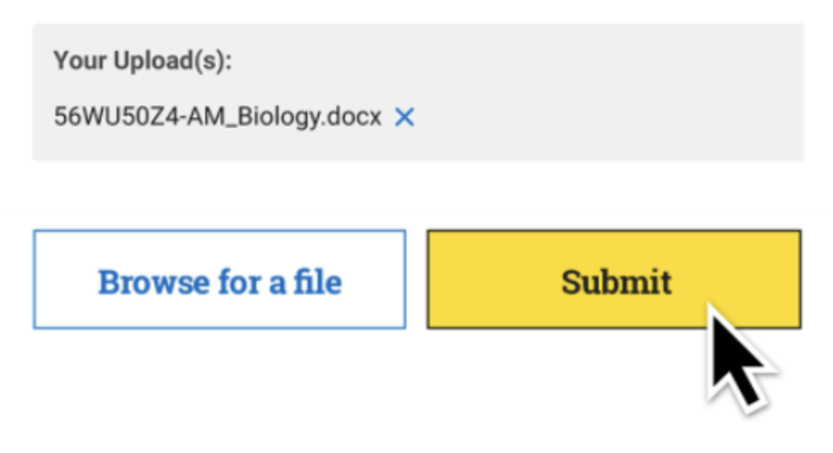
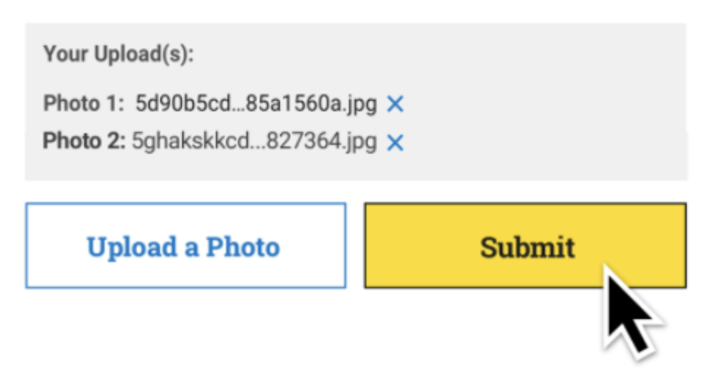
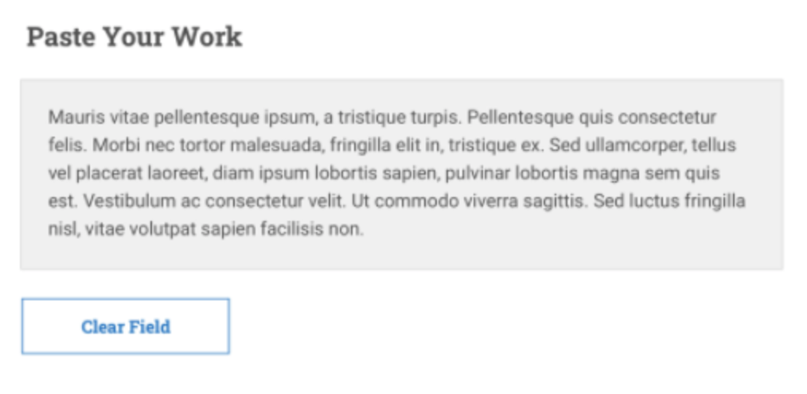
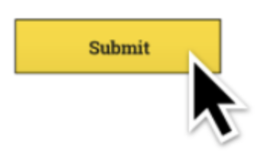
Submitting Your Response
Submitting responses is a two-step process:
  Attaching or pasting your response
  Clicking Submit
If you don’t click Submit before the timer runs out, your response will not count.
Once you click Submit, your response may continue to transfer, depending on your bandwidth. This is fine. You will be able to move on to the next question, even while your first question continues to transfer, so long as you clicked Submit before the time ran out.
If your response continues to transfer after the exam ends – wait for an on-screen message confirming that your exam is complete–make sure your submissions have fully loaded before you close your browser or turn off or restart your computer.
If you never see that “Your AP Exam is Complete” message, you should go to cb.org/requestmakeup to explain the situation and request an e-ticket for the June make-up date.
Attached Text File
Attached Photos
Pasted Text Response

Slide 6
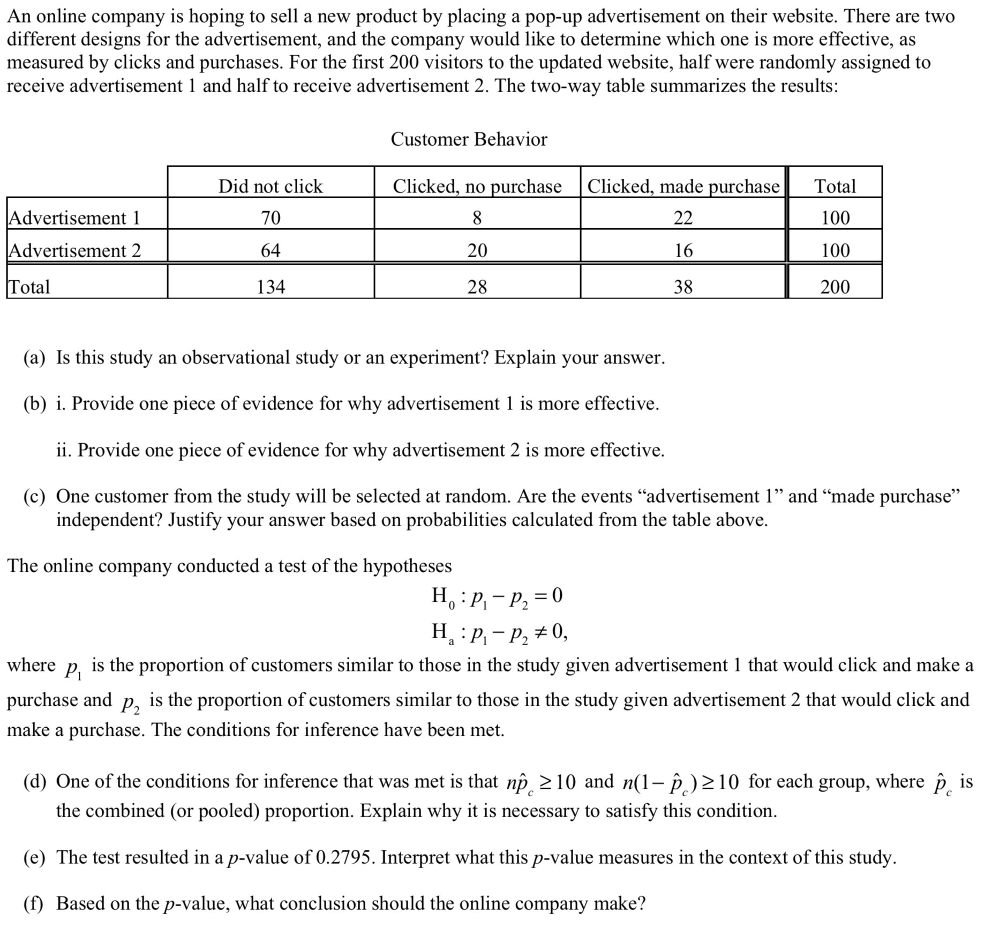
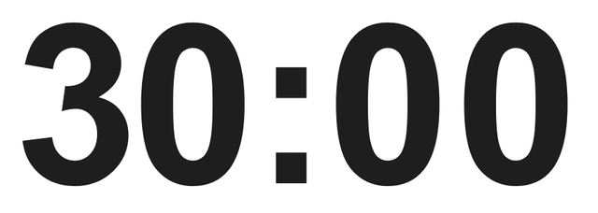
Sample Question 1
Allotted time: 25 minutes
(plus 5 minutes to submit)
Time Left to Submit Work

Slide 7
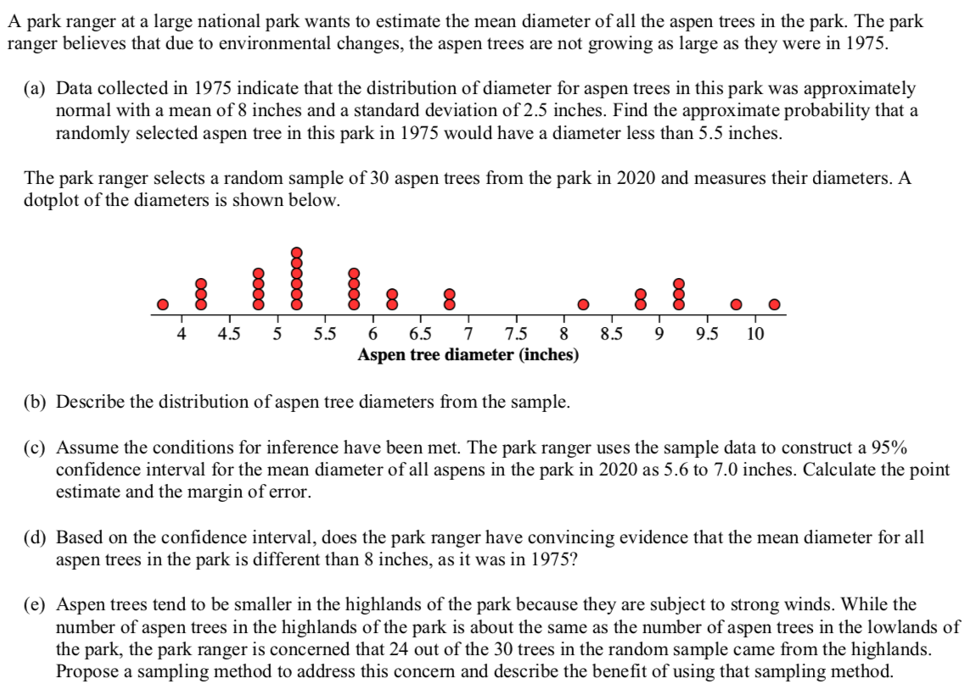

Sample Question 2
Allotted time: 15 minutes
(plus 5 minutes to submit)
Time Left to Submit Work

